Slide 1
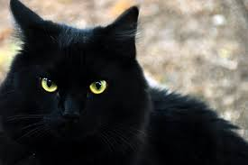
BLACK CAT COOL CAT

Slide 2
ART RULES
All classroom rules apply
HAVE FUN!
Raise your hand and ask for help BEFORE you get frustrated
Don’t jump ahead of the steps you are given.
I don’t want your art to be “perfect” there is no such thing as perfect in art. Just let it be yours
KEEP IT POSITIVE when talking about your work and other classmate’s work
Sometimes less is more – especially when we work with paint!
HAVE FUN!

Slide 3
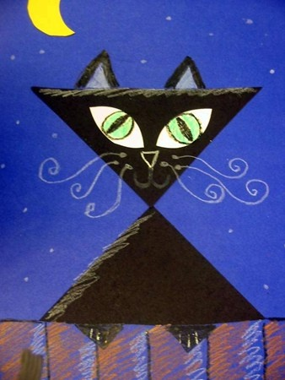
Today we will be working with:
Construction paper
Scissors
Glue
Watercolor pencils
Today we will learn:
Line direction – which lines are horizontal, vertical and diagonal
Art sometimes uses lots of different shapes – what shapes do you see?
What type of art are we doing?
ABSTRACT ART - A style of art that is not realistic. Unusual lines, colors, and shapes make the subject look unrealistic. It is often characterized by the use of geometric lines and shapes and bold, bright colors.

